Slide 1
Spatio Temporal Hot Spot Analysis of Two Crime Types In DC
Theodore Reuter

Slide 2
Introduction
As a city, Washington DC has been undergoing rapid change for the past 20 years, with a large increase in population growth, gentrification, and growth in property values as it has become a destination city for well educated young folks looking for a dense, walkable urban environment. The population has risen from 572,059 in 2000 711,571 in 2019, an increase of almost 25%.
How has this changed affected the city?
DC has a long history with crime, from the devastation of the ‘68 riots to crack and cocaine in the 80s and 90s
As a DC resident and born and raised local, I want to know how crime distribution has changed and evolved in the city over the years

Slide 3
Research Questions
What neighborhoods in DC are hotspots for the following crimes: Sex Crimes and Theft
How have these hotspots changed between 2008 and 2017? How much have they changed? If they have moved, where to?
How statistically significant are these hotspots?

Slide 4
Background
Hot spot analysis is a popular crime study topic
Most people study how hotspots predict crime – this study will not but rather look at how they changed in the past
“Most hotspots remain stable over time, or at least do not become displaced into adjacent areas when police crackdown on illegal activity” (Bones, 2015)
Leads me to suspect there will a certain degree of stability in hotspots, but I feel DC has changed so much there will be shifting
Reviews of different hotspot techniques have “determined which of these techniques is best for helping determine where spatial patterns of crime may occur in the future.” (Chainey, 2008).
Z-score is the critical value of how hotspots function – this will be the value I will look for change in, to assess hotspots changing

Slide 5
Research Objective
To quantitatively determine how crime hotspots patterns have shifted over time
To discover any underlying quirks in crime growth and change over time
Reject null hypothesis: “There has been no significant change in the distribution of sex crimes or theft in DC from 2008 to 2017.

Slide 6
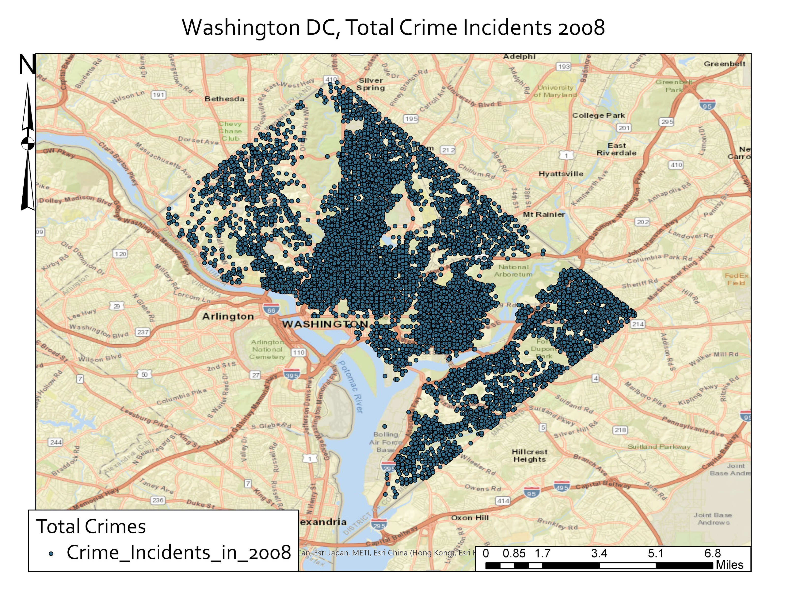
Data
Sourced from DC Open Data Catalog - https://opendata.dc.gov/
Data here is rigorously prepared, and collected from municipal sources – in this case the Metropolitan Police Department
Has crime incident shapefiles representing all crime incidents from a given year
Each point represents one recorded crime incident – recorded with numerous attributes including type, location, type, method, and more.
Downloaded data for 2008, 2011, 2014, 2017
Separated each by crime type for each year and then joined crime types to polygons
Used 2010 census tracts as aggregation polygons

Slide 7
Data Pre-Processing
Had to spatially join crime counts to each polygon – how many theft incidents were there in a specific polygon in a particular year? How many sex crimes?
Preform this for each census tract, each year, and both crime types – sex crime and theft
Calculate crime rates – a normalized equal rate across spatially/population unequal polygons
Had to estimate population for each census tract – assumed each tract maintained same population proportion of total population in a given year as it did in 2010
Got crime counts and crime rate for sex crimes and theft for year of interest – 2008, 2011, 2014, 2017
 | Year
Type | 2008 | 2011 | 2014 | 2017
Theft | 17578 | 10134 | 14593 | 14442
Sex Abuse | 136 | 176 | 316 | 291
DC Pop | 580236 | 620427 | 658893 | 693972
CRIME COUNTS:

Slide 8
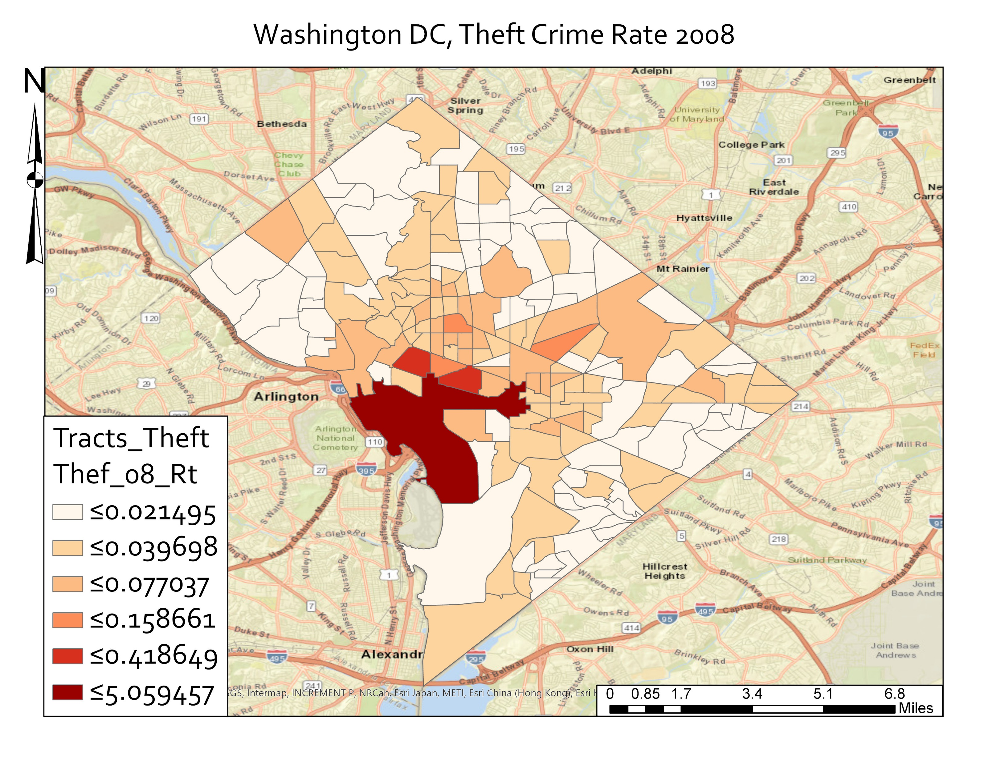
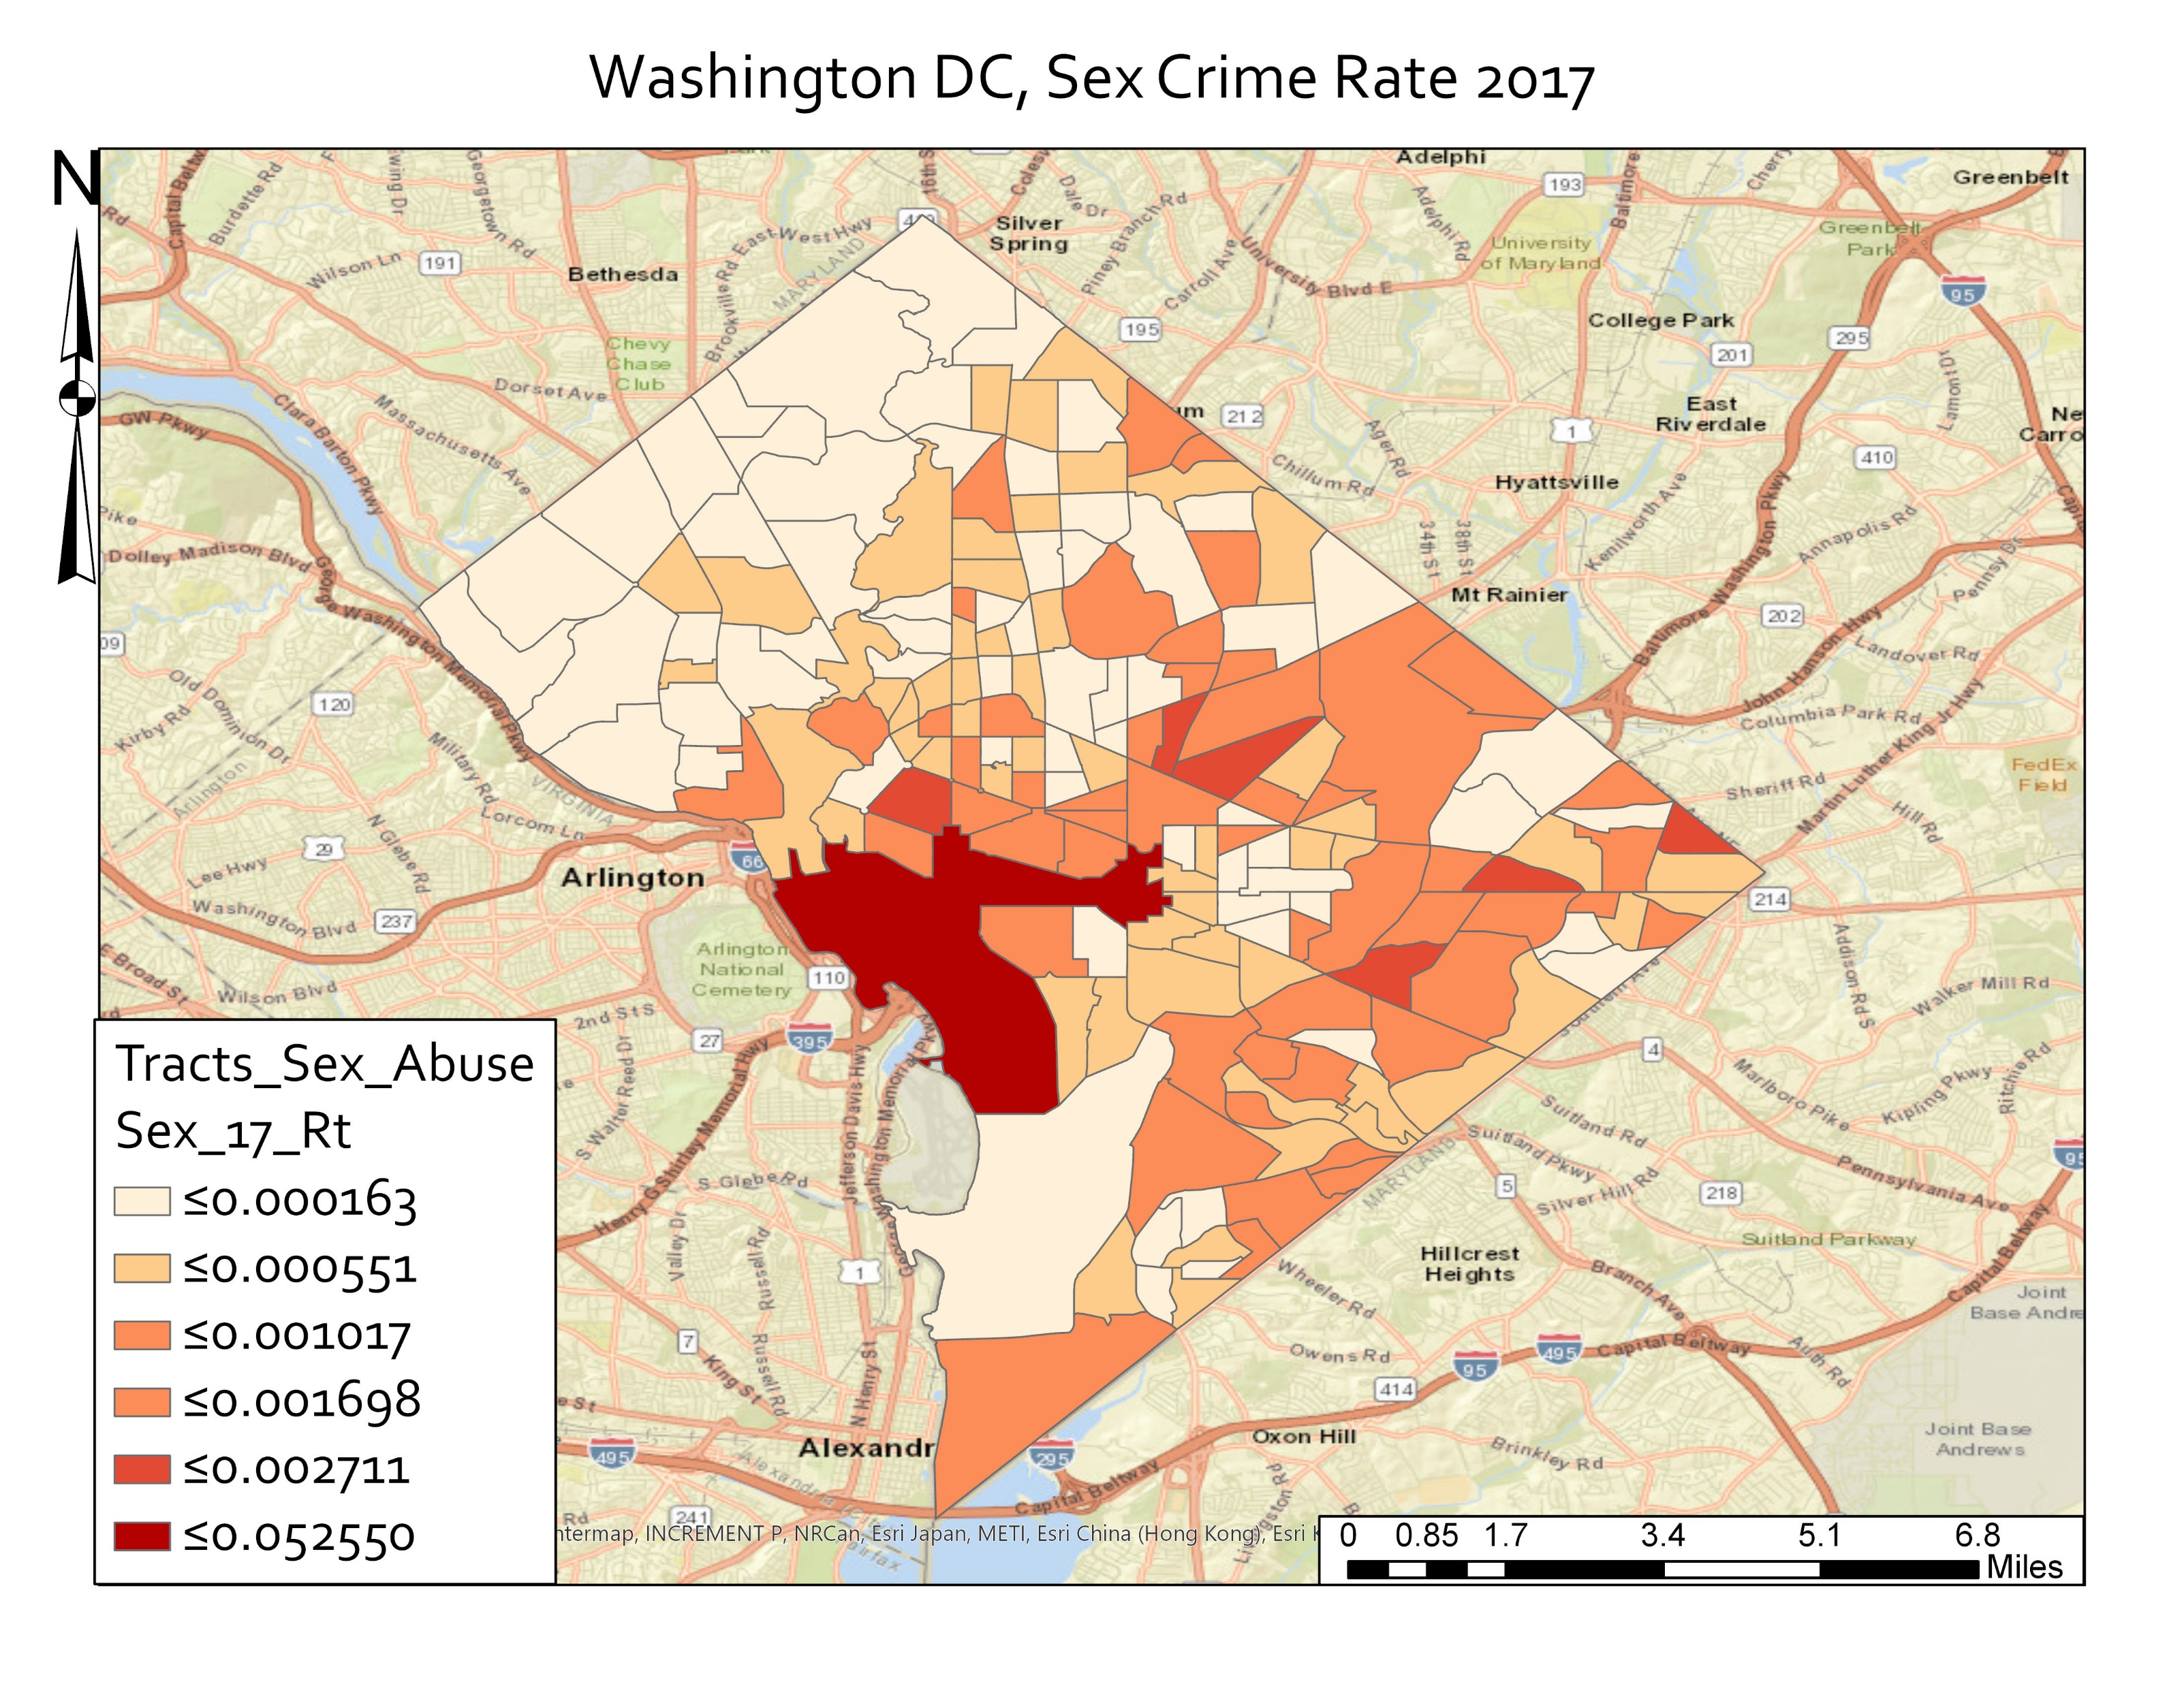
Data Pre-Processing – Example Results

Slide 9
Data Preprocessing Note
Note the extremely high crime rate on the national Mall Tract
Due to the very low population – 33. Next closest population of a tract is 1189
Similar absolute numbers of crimes as nearby census tracts, but the very low population results in an artificially high crime rate, multiple orders of magnitude larger than others
At beginning of project I wondered if this would cause issues and it eventually did. A question running through this project was – what is the best way to deal with such an extreme outlier in such a central portion of the city?

Slide 10
Methods
Study spatial autocorrelation first to study global trends – Global Moran’s I
Study global clustering using General G statistic
Study local clustering relationships using Local Morans I
Study local hotspots using Hot Spot Analysis Tool and Getis-Ord Gi* tool.
Compare how hotspots have changed over time – calculate difference in GiZscores
Will use ArcGIS Pro geoprocessing tools to conduct analysis
Assumptions:
Each crime is spatially independent
Rates have a normal distribution

Slide 11
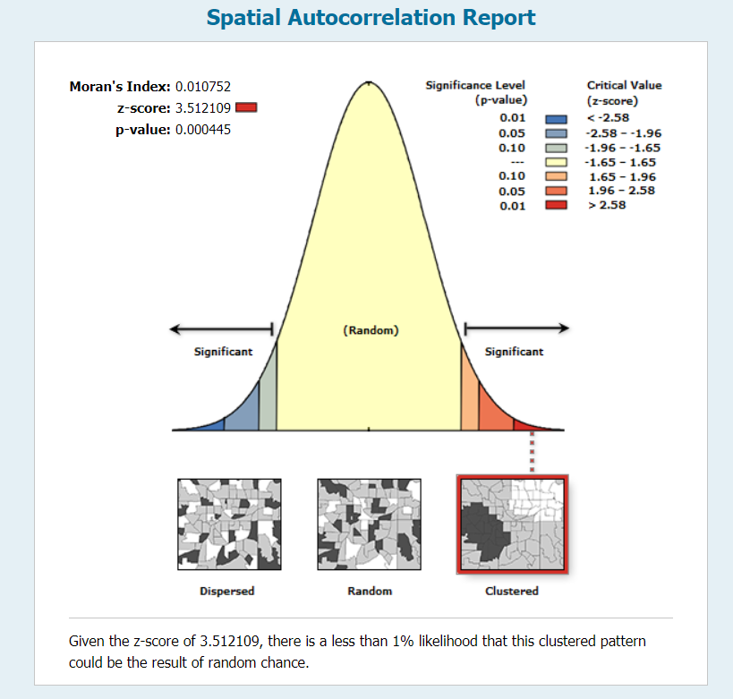
Results – Spatial Auto Correlation
Year | Morans Score | Z score | P value | Clust/Ran/Disp
2008 Sex Abuse Rate | 0.018178 | 0.812858 | 0.416300 | Random
2011 Sex Abuse Rate | -0.004615 | 0.400665 | 0.688667 | Random
2014 Sex Abuse Rate | -0.002240 | 0.796105 | 0.425971 | Random
2017 Sex Abuse Rate | 0.004294 | 1.691539 | 0.090734 | Clustered – less than 10% chance random
Year | Morans Score | Z Score | P Value | Clust/Ran/Disp
2008 Theft Rate | 0.010752 | 3.512109 | 0.000445 | Highly clustered - less than 1% chance random
2011 Theft Rate | 0.014107 | 4.347231 | 0.000014 | Same as above
2014 Theft Rate | 0.010906 | 4.148080 | 0.000034 | Same as above
2017 Theft Rate | 0.020736 | 4.611279 | 0.000004 | Same as above
Theft showed a high rate of global spatial autocorrelation
High or low concentrations of theft were often near other areas of high or low theft rates
Sex crimes showed little to no global spatial autocorrelation
Sex crimes were close to being distributed randomly across the city
Not likely to find areas of high or low concentrations of sex crimes near other areas of high or low sex crime rates
Global Morans I – Theft Rt 2008

Slide 12
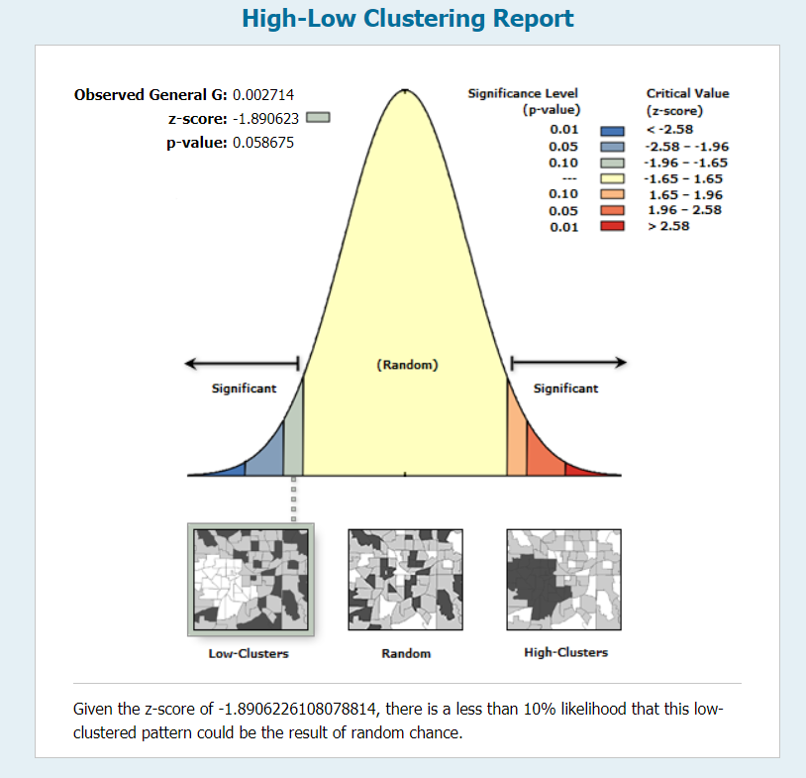
Results – Global G Statistic
Year | Obs General G | Expected G | Z score | P Value | Clust/Ran/Disp
2008 Sex Abuse Rt | 0.005772 | 0.005618 | 0.434303 | 0.664068 | Random
2011 Sex Abuse Rt | 0.002714 | 0.005618 | -1.890623 | 0.058675 | Low clusters – less 10% chance rand
2014 Sex Abuse Rt | 0.004495 | 0.005618 | -0.889988 | 0.373473 | Random
2017 Sex Abuse Rt | 0.005733 | 0.005618 | 0.107144 | 0.914675 | Random
Year | Obs General G | Expected G | Z score | P Value | Clust/Ran/Disp
Theft Rt 08 | 0.008249 | 0.005618 | 1.932395 | 0.053311 | High clust, less 10% chance rand
Theft Rt 11 | 0.010463 | 0.005618 | 2.890402 | 0.003847 | V hi-clust, less 1% chance rand
Theft Rt 14 | 0.009642 | 0.005618 | 2.560318 | 0.010458 | Med hi clust, less 5% chance rand
Theft Rt 17 | 0.009166 | 0.005618 | 3.046051 | 0.002319 | Hi-clus, less 1% chance rand
Thefts again demonstrated a high degree of global clustering
Sex crimes rarely showed a statistically significant degree of clustering
General G Statistic – Sex Rate 2011

Slide 13
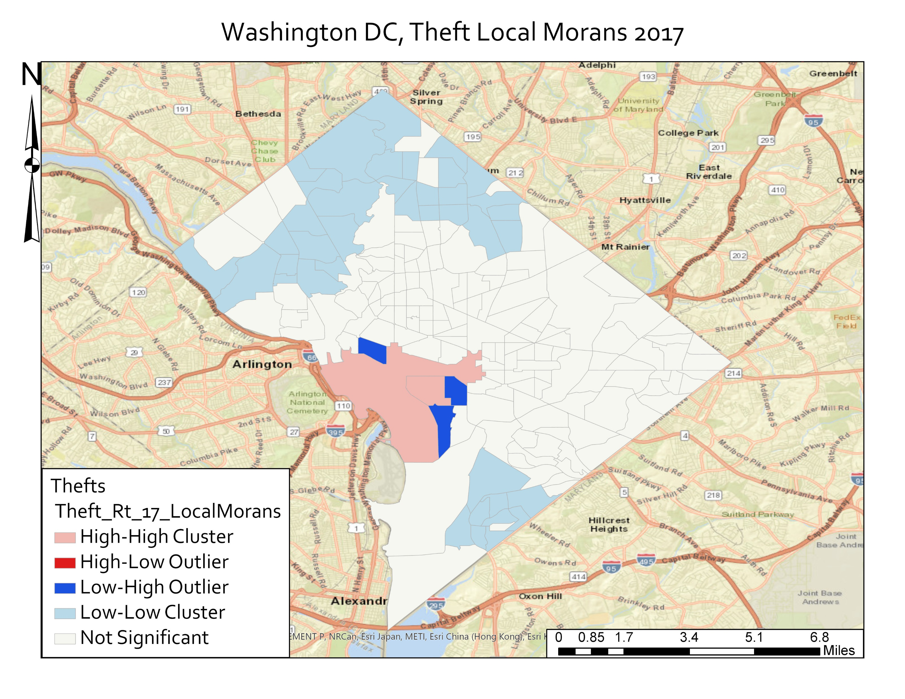
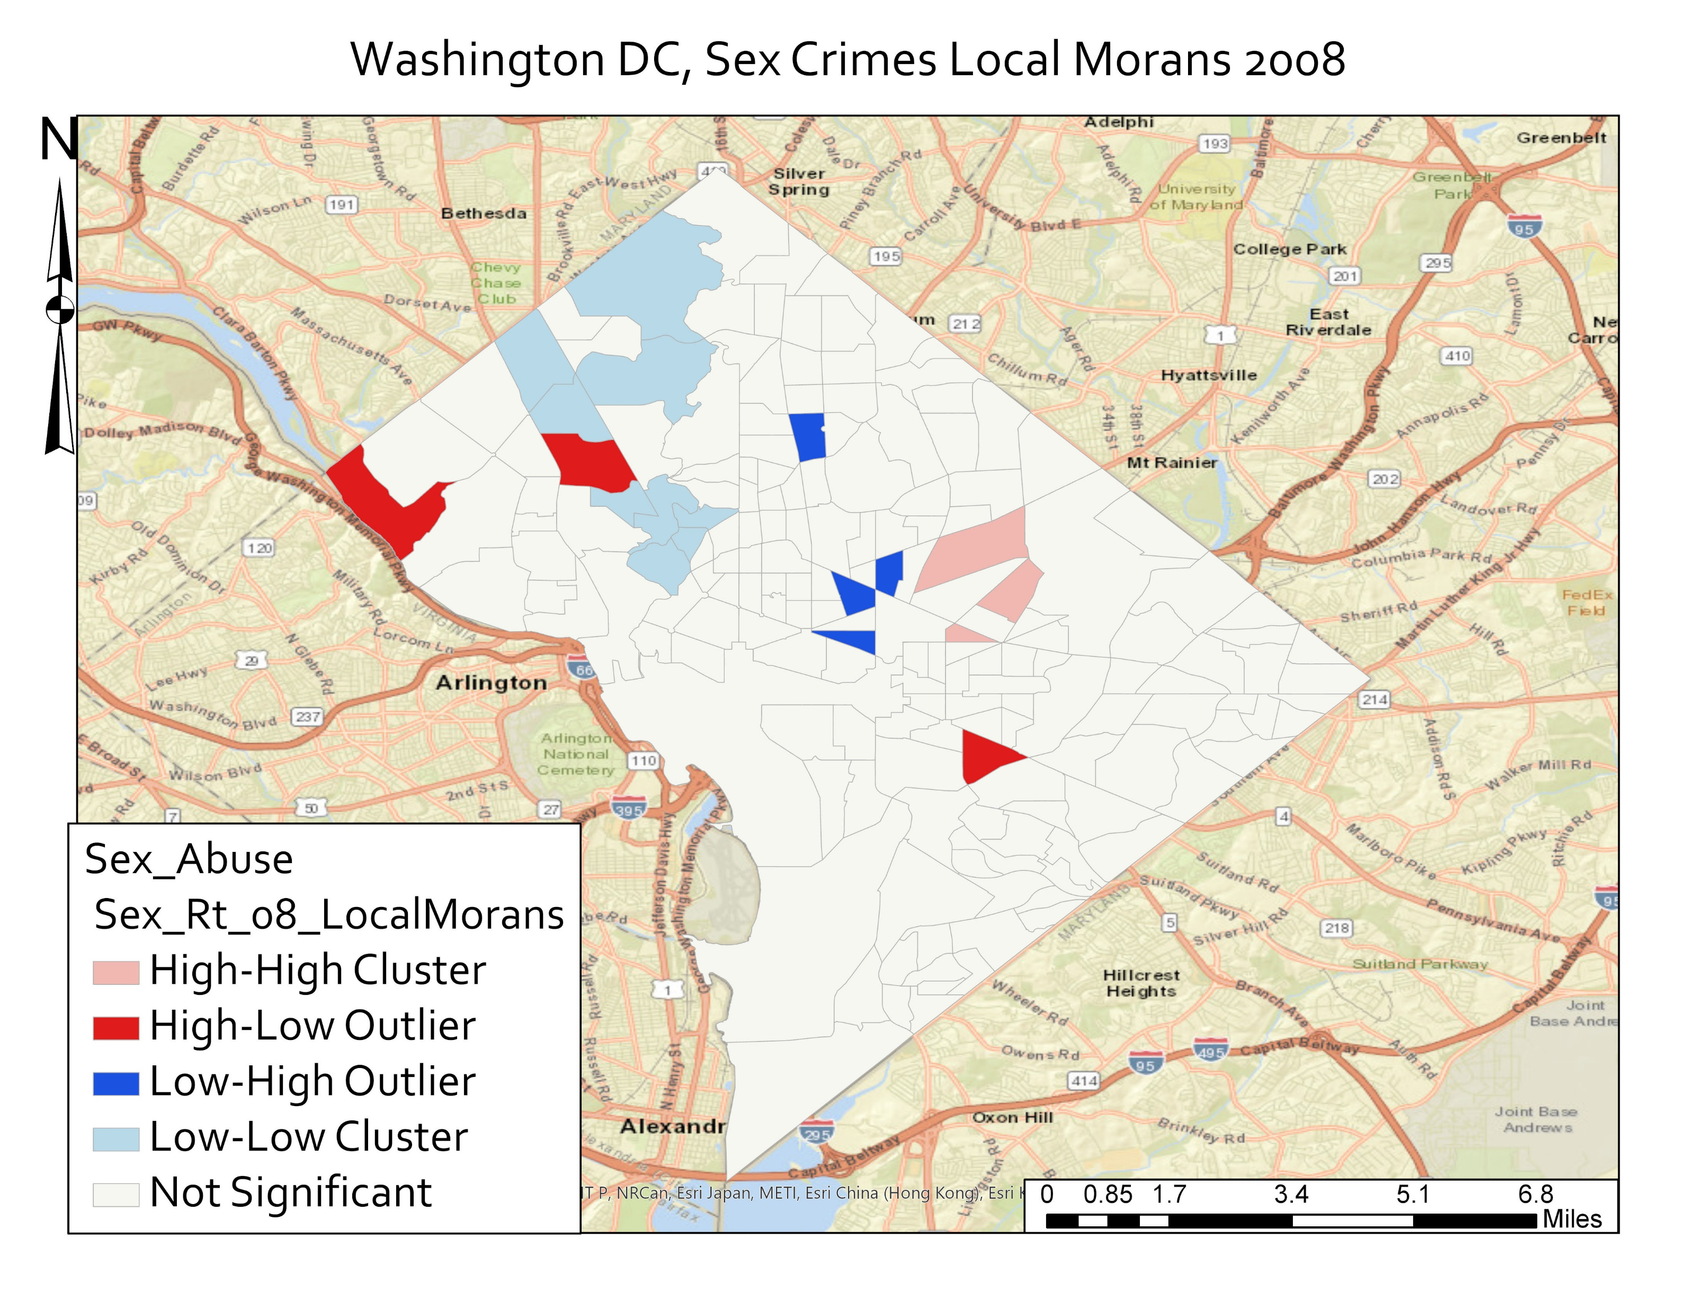
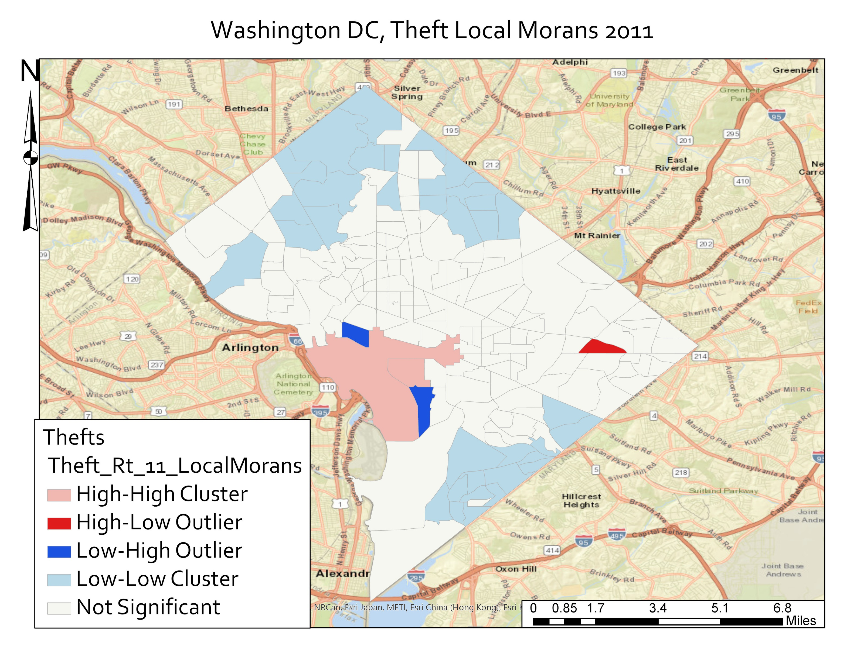
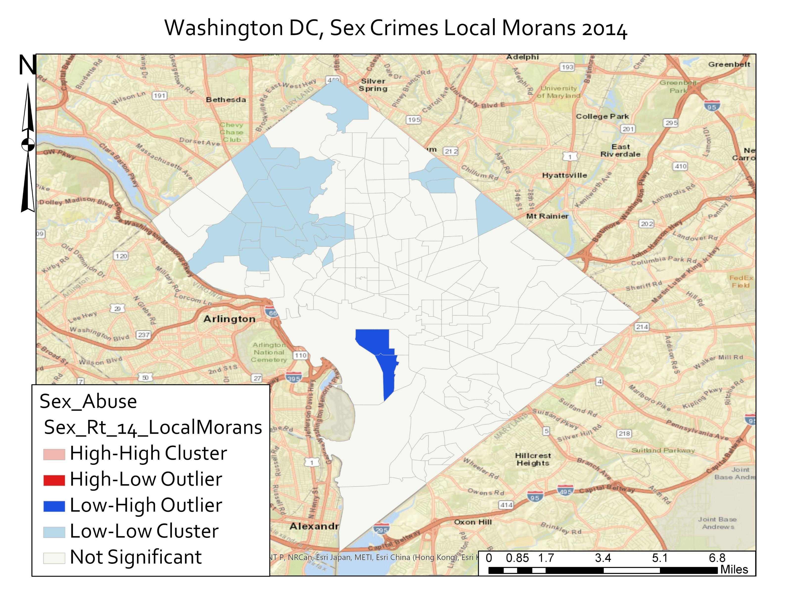
Results – Local Clustering - Samples

Slide 14
Results – Local Clustering
Theft Crimes:
Persistent high-high clustering around the National Mall, indicating high rates near other high rates
A few persistent low-high clusters near the National Mall indicating outlier low rates hear an area of high rates
Generally persistent low-low clustering in NW DC indicating areas of low values near other areas of low values. Expected due to long term affluence of NW DC.
Sex Crimes:
Similar patterns as to theft – large area of low-low clustering in NW DC, indicating areas of low crime rates near other areas of low crime rates. Expected due to the high income rates there, which is associated with less crime
Problem with absolute/vs calculated rates. Some areas of ‘high-low’ clustering only had a single incident. Low in absolute terms, but much higher in relative crime rate terms, producing the high-low outlier we see when the reality is more mixed
This issue cropped up repeatedly, with low absolute number of sex crimes

Slide 15
Results – Hot Spot Analysis: A Note
Encountered a serious problem and had to adjust methodology
As mentioned earlier, National Mall tract has artificially high crime rates – 1-2 orders of magnitude higher, for all years and both crime types
Example Sex Crime 2017:
National Mall Crime Rate: 0.05255 Total median Crime Rate: 0.0003009
Histogram Skewness: 12.8 Mean Crime Rate: 0.0007563
Extreme outlier
For theft and sex crimes, National Mall globally skewed hotspots for all tests in all years – as seen in following slide
Was forced to remove National Mall tract from dataset so hotspot analysis could reveal patterns elsewhere in city. Not sure how best to deal with such an issue
Raised a number of question that would be excellent for follow up studies – how to deal with such an extreme outlier.

Slide 16
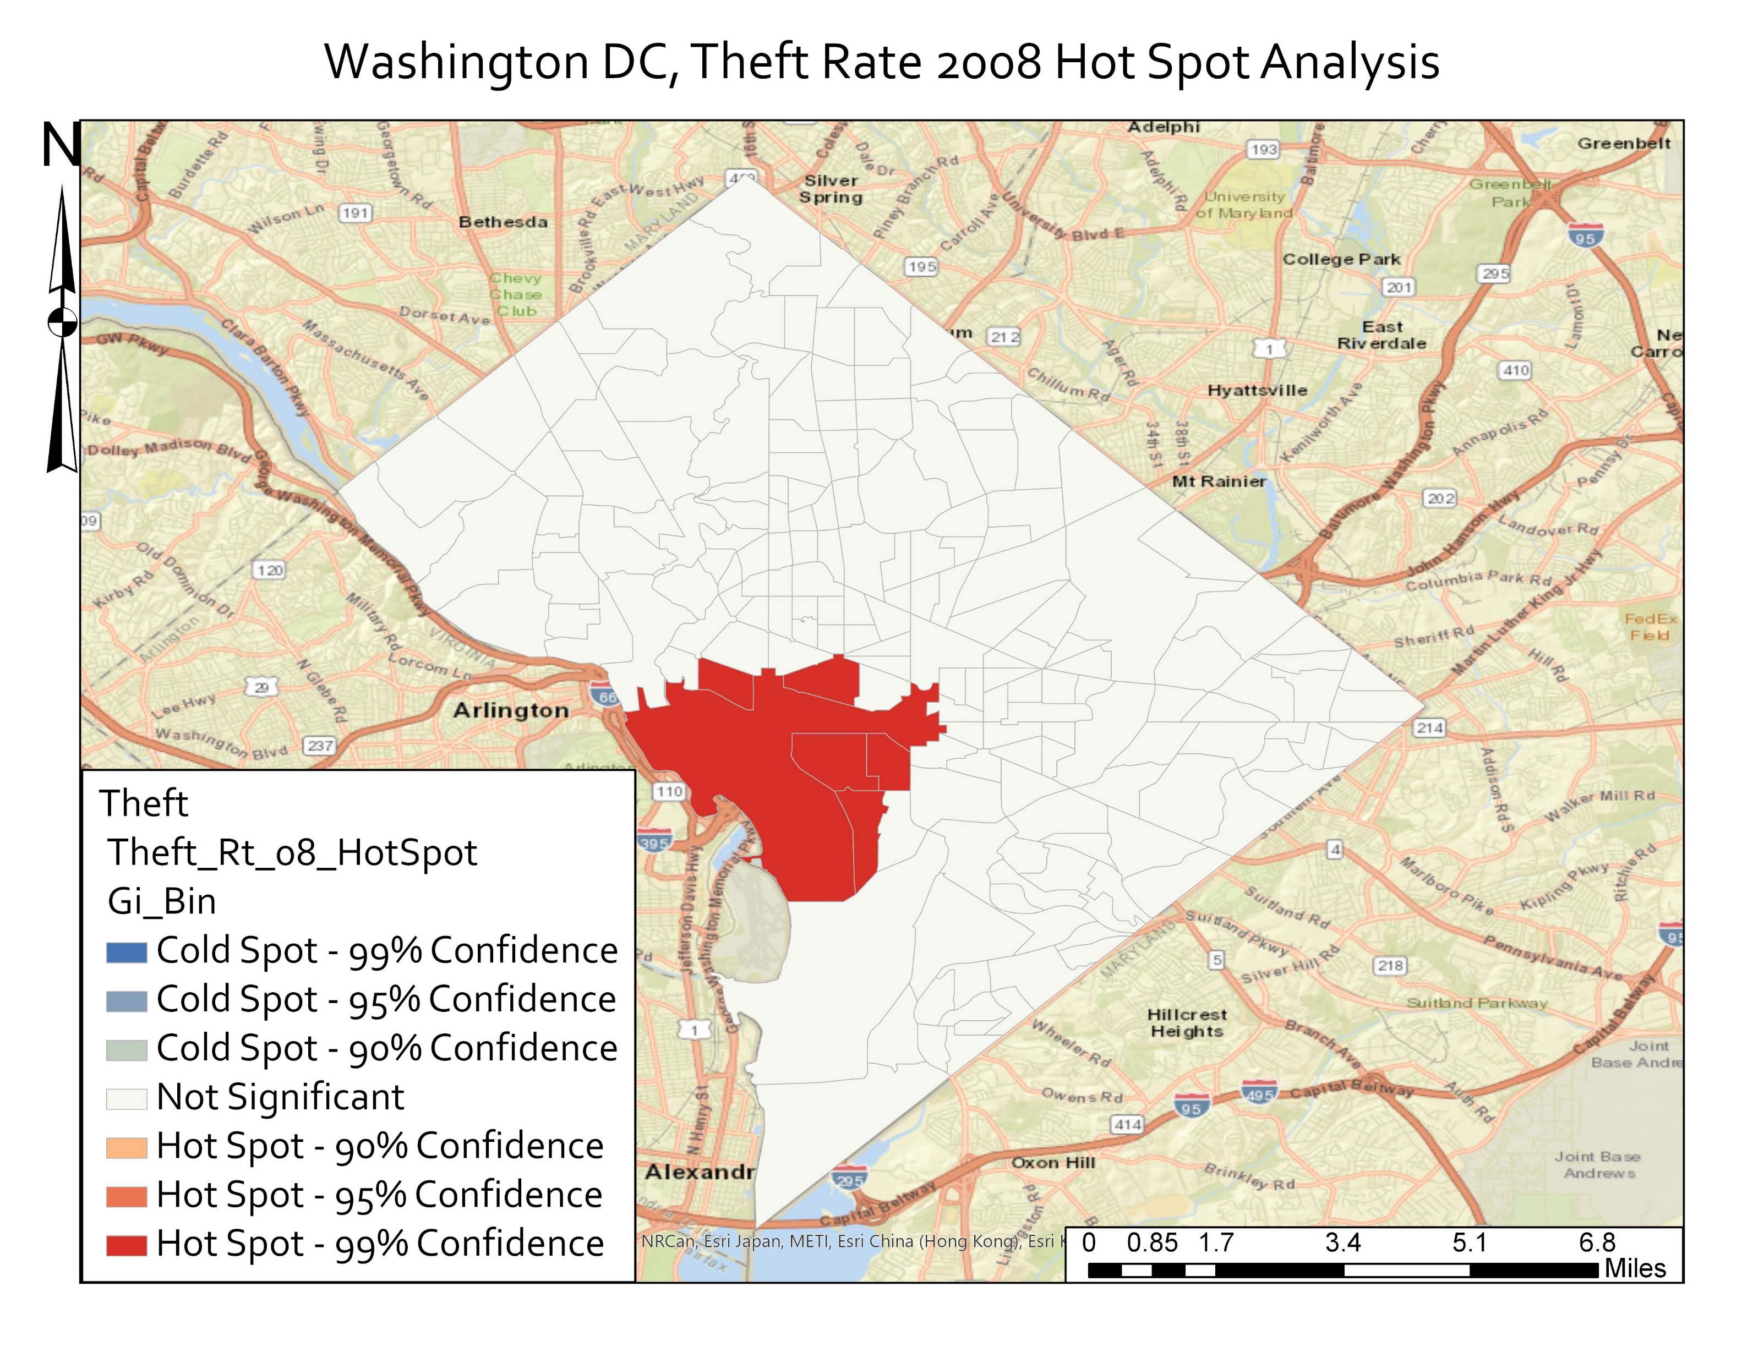

Results – Hot Spot Analysis - Including National Mall
All Hotspot Analysis Results were extremely similar
Provides no information on rest of city
Artificially high crime rate on National Mall skews everything else

Slide 17
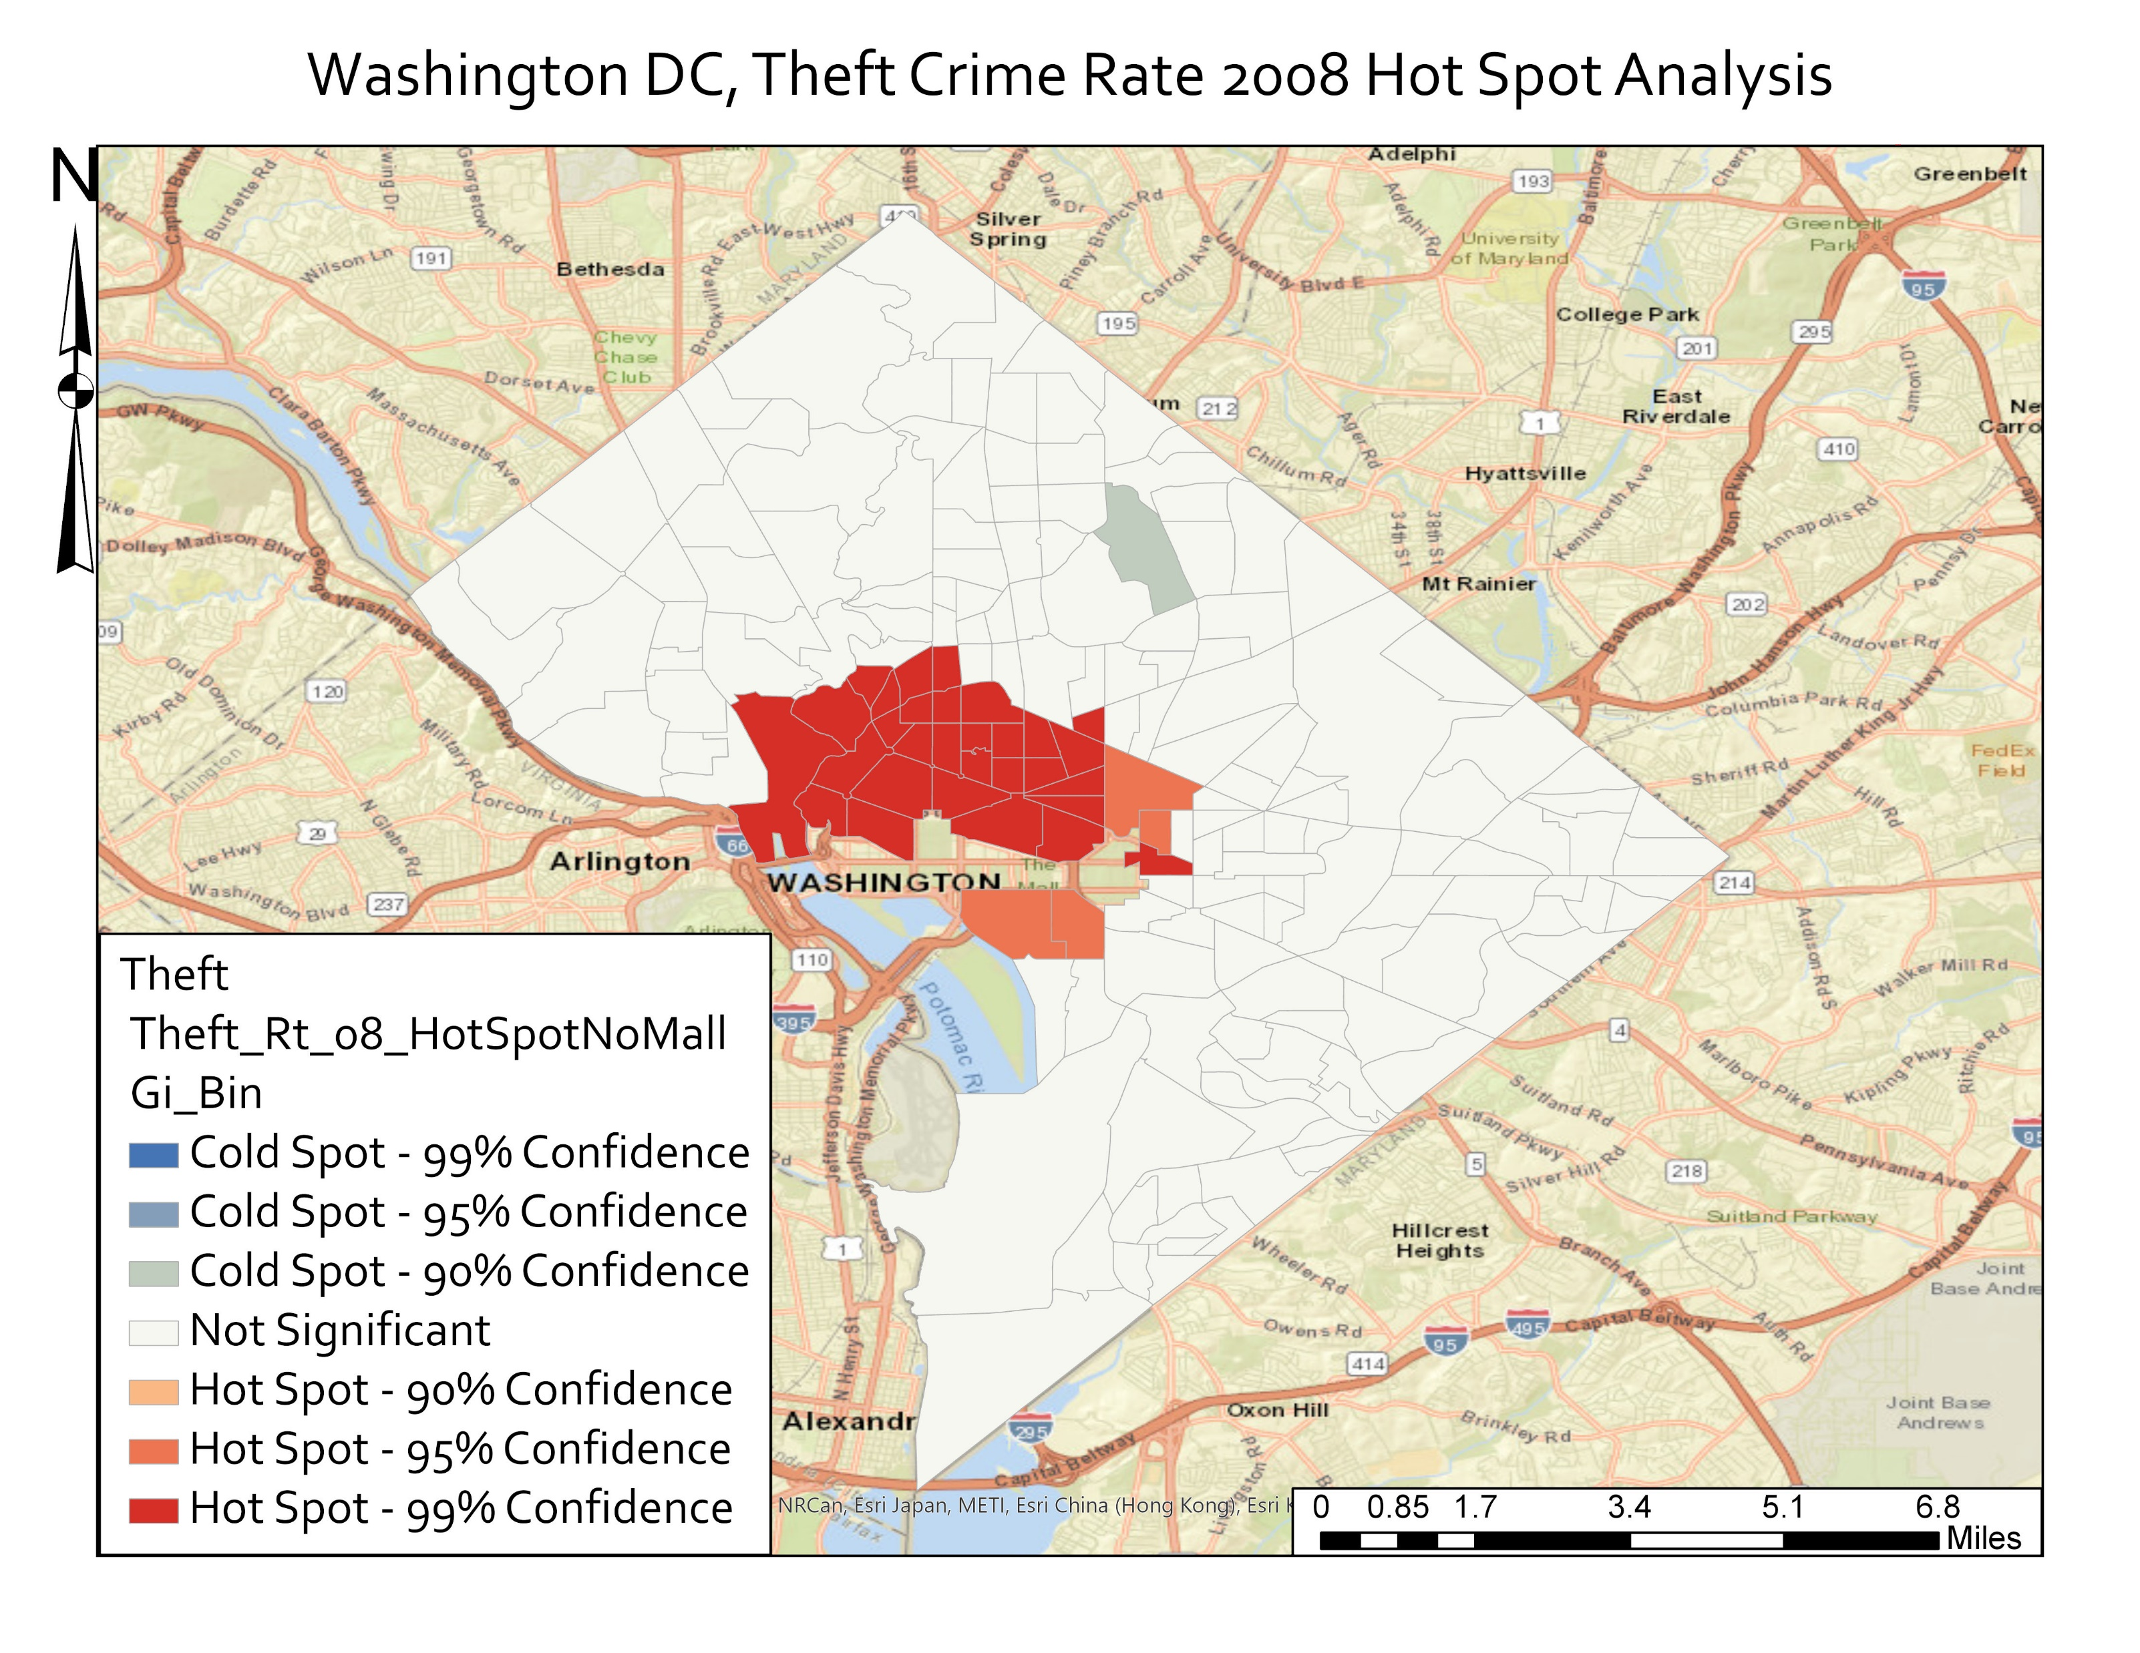
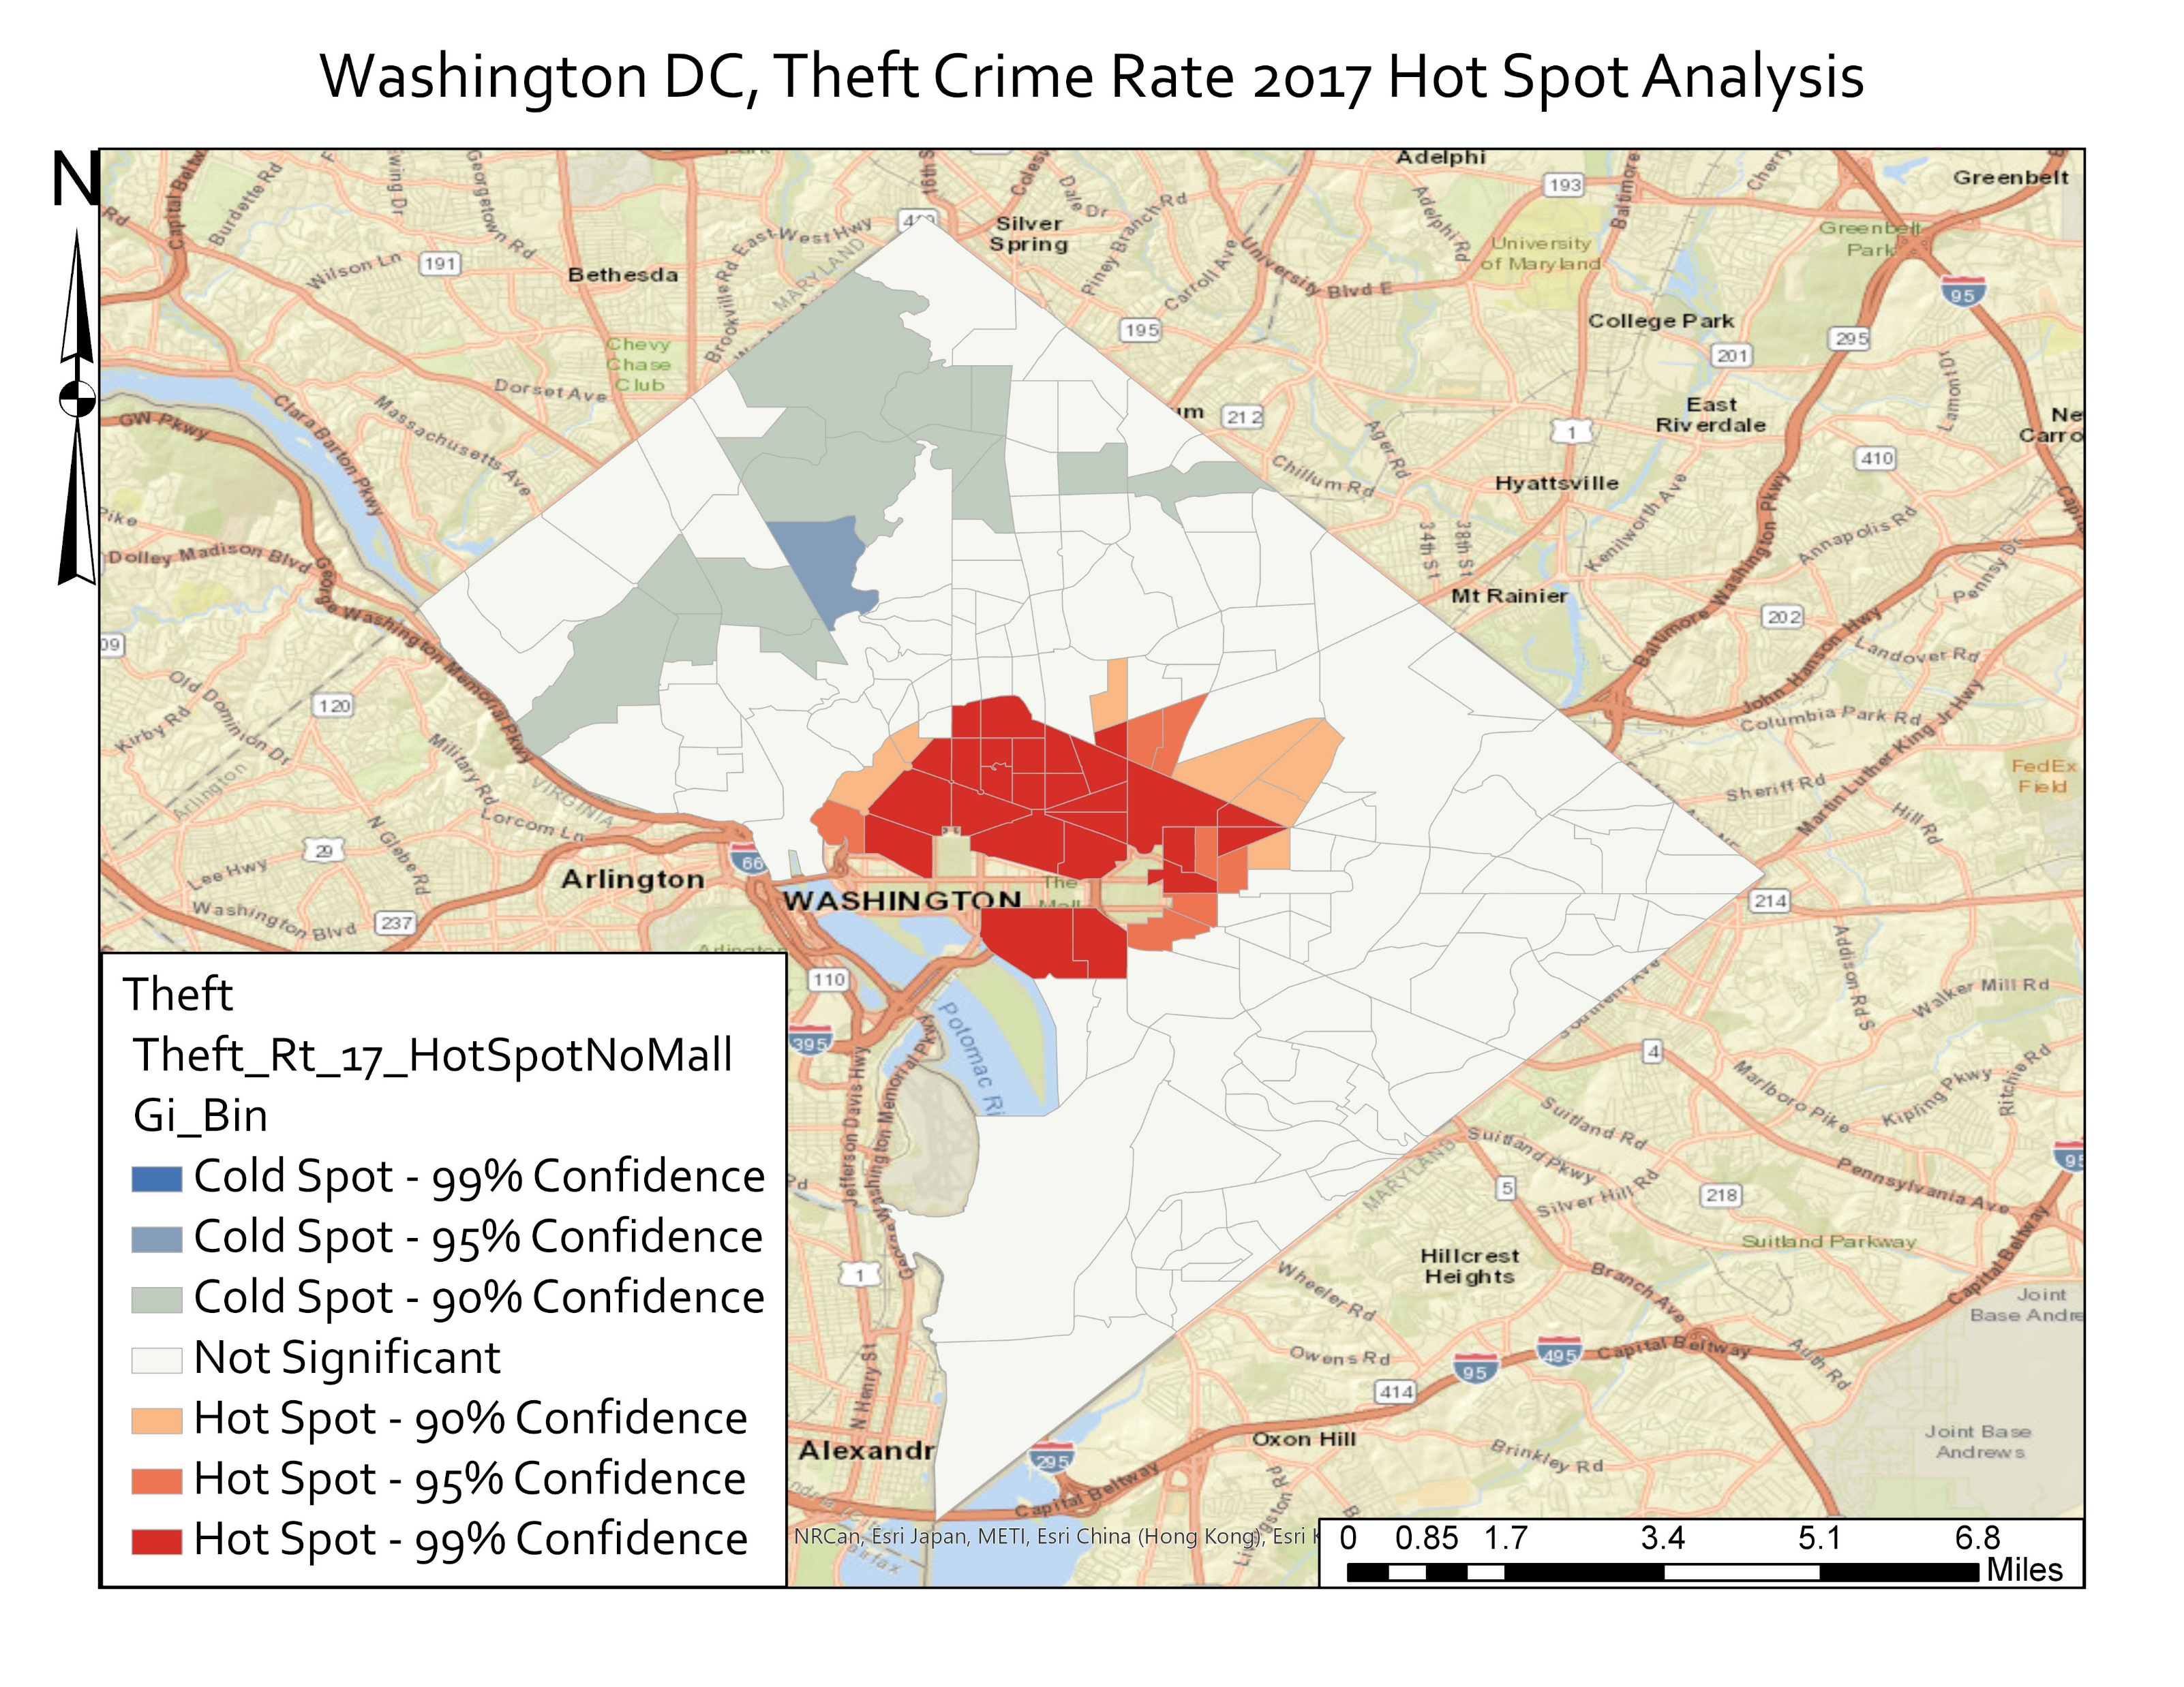
Hot Spot Analysis – Theft – No National Mall
Much better results without National Mall
Chose to preform all hotspot analyses without National Mall census tract

Slide 18
Hot Spot Analysis - Theft
Removing National Mall showed hotspots elsewhere in city confirming the skewing nature of the National Mall tract
Reinforced suspected hypothesis – theft concentrated in major commercial areas with bars and nightlife – Dupont Circle, Adams Morgan, U St
Also areas with lots of people – downtown DC, areas around the National Mall
Cold spots in NW DC, again expected due to historical affluence
Surprisingly, very little change in hotspot distribution over time – hot spots stay around the downtown and National Mall area.

Slide 19
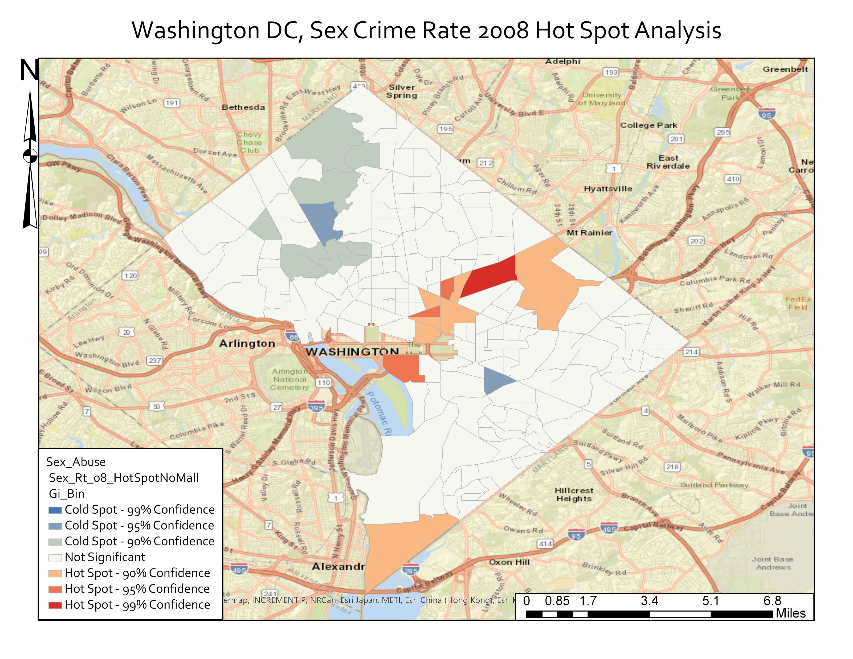
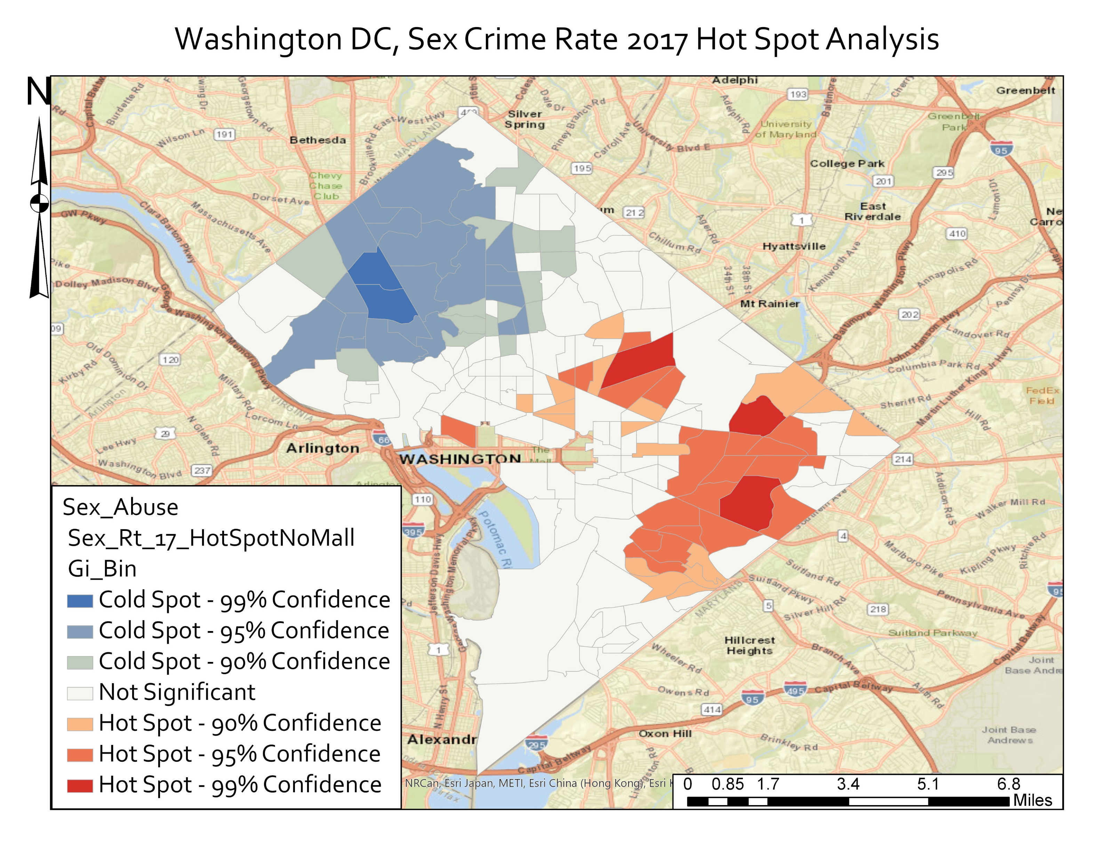
Hot Spot Analysis – Sex Crimes – No National Mall

Slide 20
Hot Spot Analysis – Sex Crimes
Removing National Mall tract revealed a lot of hot spot patterns elsewhere in city, confirming skewing nature of National Mall’s artificially high crime rate
Persistent cold spots in NW of DC around Tenleytown, Van Ness, Cleveland Park – similar to what is seen elsewhere. Affluent areas of city have generally lower crime rates
Spreading of cool spots in NW DC over time
Large increase in hotspots in SE and NE DC
In 2008 hot spots were around Union Station, in 2017 they moved north to the Florida Ave/Union Market/Gallaudet University area and SE across the Anacostia River

Slide 21
Hot Spot Analysis – Change Over Time
For thefts, we saw a largely unchanged hot spot distribution from 2008 – 2017 – concentrated in central and downtown DC
For sex crimes, a large expansion of hot spots in SE DC and a large expansion of cool spots in NW DC from 2008-2017
Want to quantify this change
Maybe there is change happening that is not visible by the hotspot maps
Chose to calculate Zdiff_0817 – subtract the GiZscore_2008 from the GiZscore_2017 for each tract
Negative result indicates a cooling, positive result indicates heating up
Z-score quantifies how hot or cold a spot is, so a difference can give us change in that hot/cold intensity

Slide 22
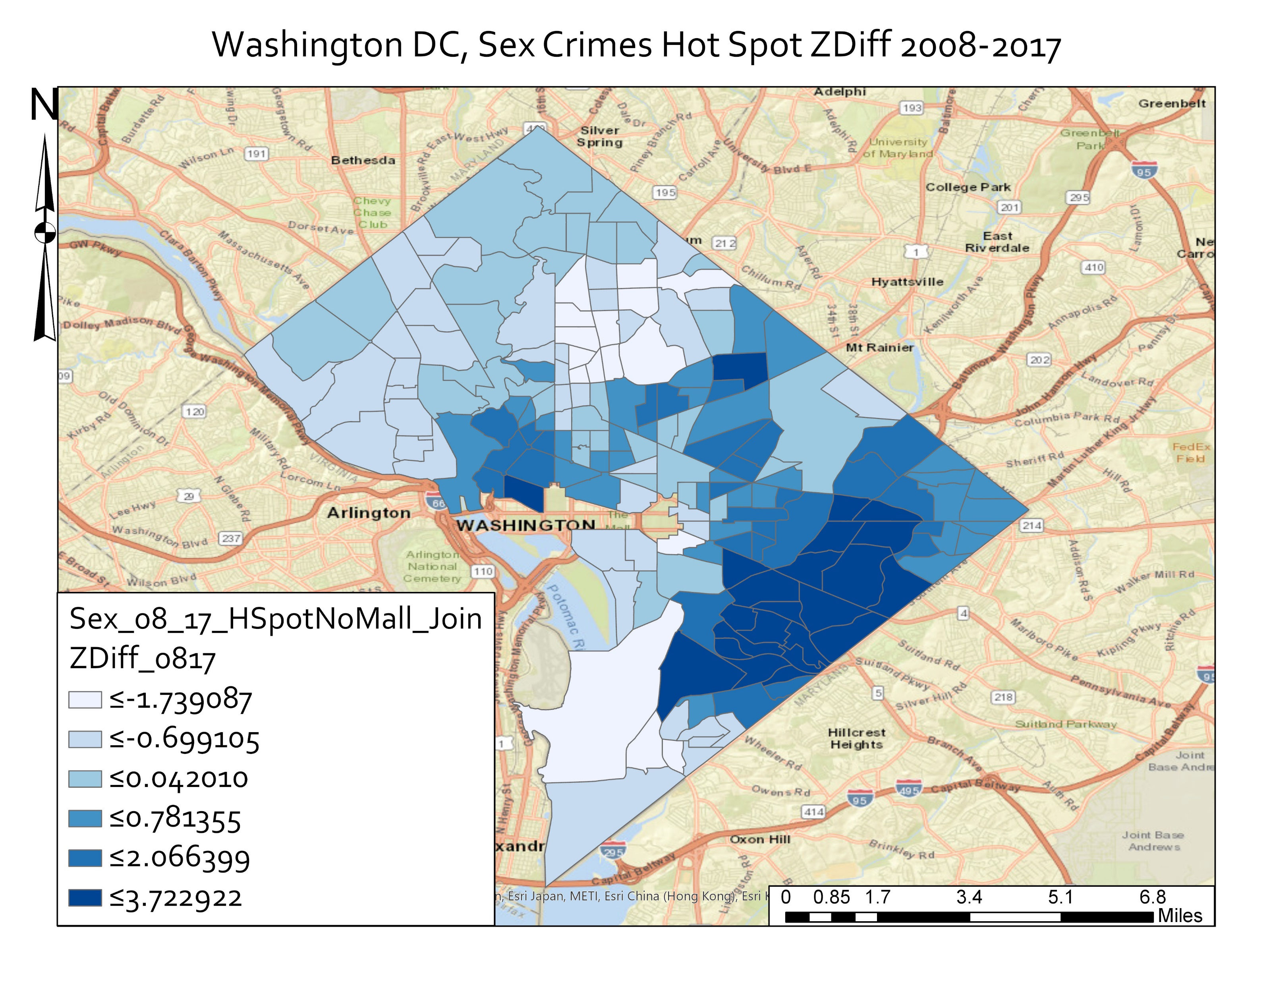
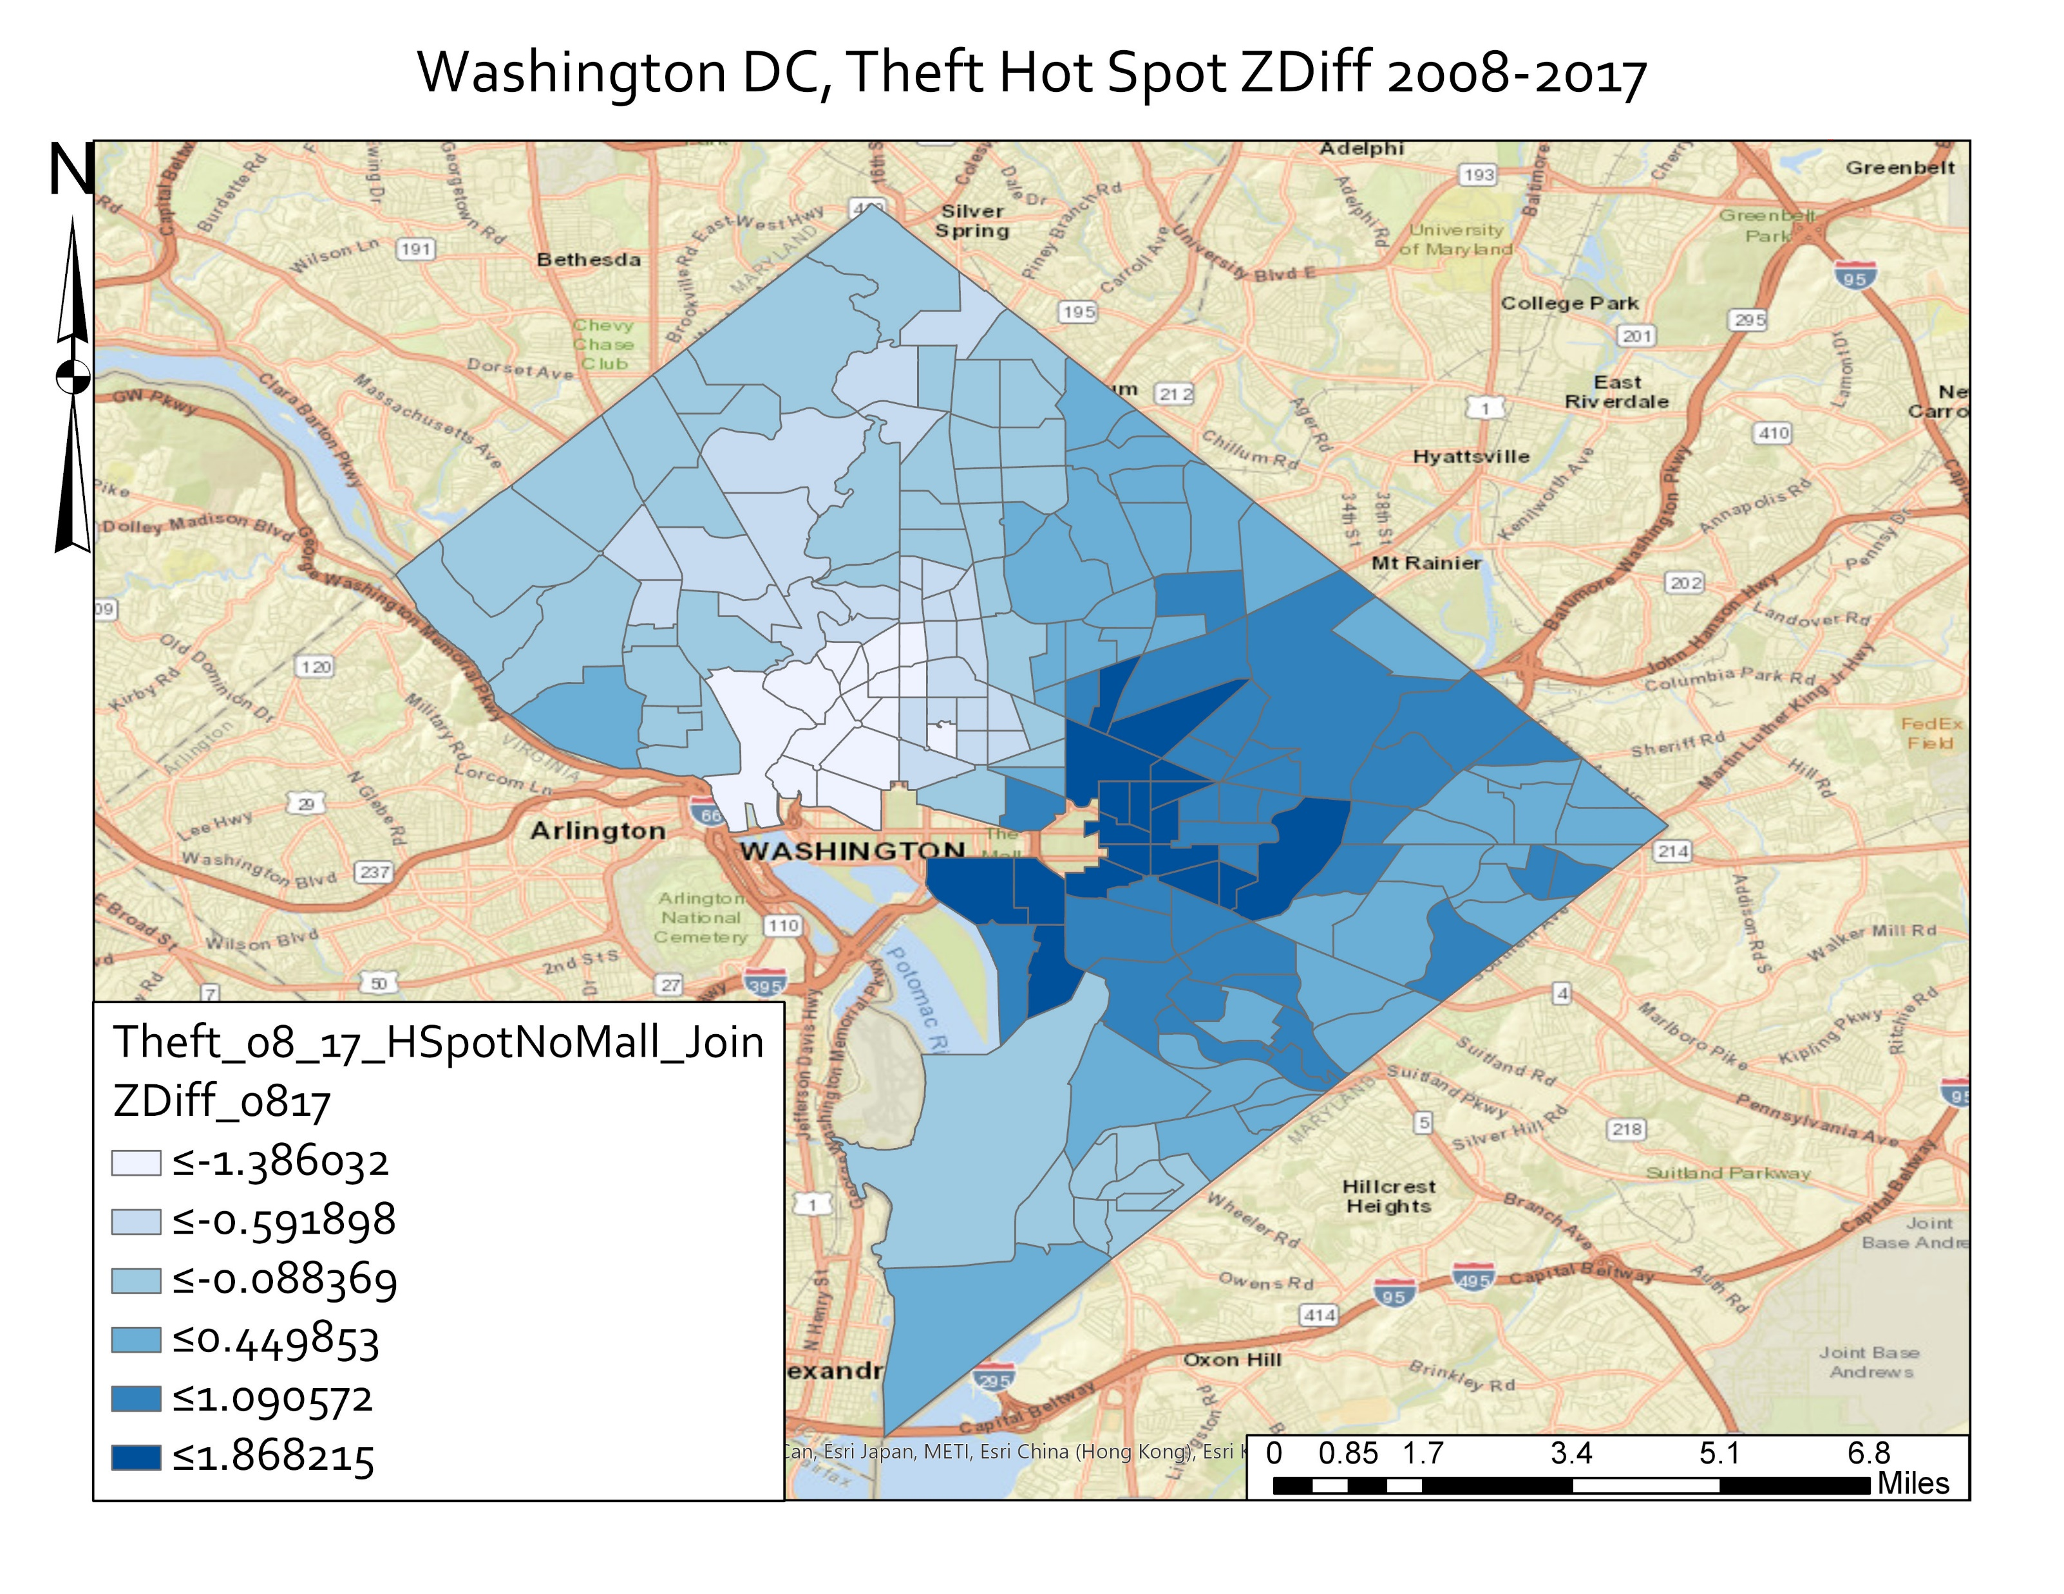
Hot-Spot Analysis - ZDiff

Slide 23
Hot Spot Analysis – Zdiff Sex Crimes
Significant trends in hot spots changing over time
Change map matched the hotspot maps – large heating up in SE DC
Usually an increase in sex crime rate had a positive Zdiff score – indicating a heating up
However a number of tracts had a drop in the total sex crime rate but had an increase in the GiZscore between 2008 and 2017.
How does a tract have a lower crime rate but increase as a hotspot?

Slide 24
Hot Spot Analysis – Zdiff Theft
A map that shows significant trends not immediately obvious in hot spot maps
Hot spot maps between 2008 and 2017 appeared to show little change in space over time – but not the story seen in the ZDiff
A cooling in the NW part of downtown, Adams Morgan, Dupont Circle, places that did remain hot spots – but cooled down significantly
Crime rates stayed statistically significantly higher than that of surrounding tracts
Heating up east of the Capitol and National Mall in H St and Union Station, Eastern Market areas
Again, like sex crimes, a number of tracts had a drop in crime rate while having an increase in GiZscore

Slide 25
Hot Spot Spatio-Temporal Summary
Looking at hot spot maps only one of two crimes appeared to show a significant change in hot spots over time – sex crimes
Looking at Zdiff however showed significant global trends in shifting of hotspots in both maps
Crime and hotspots heated up in the areas East and South East of the downtown and National Mall area
Unusual pattern of hot spots increasing with decreasing crime rate

Slide 26
Conclusion
Conclusively reject the null hypothesis – there has been significant change in hotspot distribution and intensity over time
Having low absolute crime numbers can throw off clustering analysis, as seen in the Local Morans for sex crimes
Sex crimes some tracts saw a change in GiZscore of up to 3, for theft some tracts had a change in GiZscore of up to 1.86, both well over the lowest critical z-score of 1.65
Raised question of increasing z-score with decreasing crime rate
Could be the result of a global crime rate decrease. DC population increased 20% between 2008-2017 while absolute thefts dropped from about 17k to 14k.
Hot spot is a local analysis, so a locally lower crime rate in a hot spot might still be higher than neighbors if neighbor crime rates also decreased
Global numbers of sex crimes more than doubled between 2008-2017 though, from 136-291, so how did these hot spots heat up but have lower crime rates?

Slide 27
Conclusion
Further Questions:
Examine closer tracts that had an increase in GiZscore with a decrease in crime rate
How best to deal with a tract with abnormal data like the National Mall – how best to account for such an outlier?
Should such an outlier be set to zero? Be removed from the dataset entirely? Given artificial population?
Can hot spot analysis tool be parametrized to account for such a gross outlier?
Why has the number of total sex crimes more than doubled while the number of thefts has dropped?

Slide 28
Bibligoraphy
Bones, Paul D.C., Hope, Trina L, Broken Neighborhoods: A Hierarchical Spatial Analysis of Assault and Disability Concentration in Washington, DC, 2015, Journal of Quantitative Criminology v31 n2, p. 311-329
Chainey, Spencer, Tompson, Lisa, Uhlig, Sebastian, The Utility of Hotspot Mapping For Predicting Spatial Patterns of Crime, 2008, Security Journal 21, no 1-2, p. 4-28
Jerry H Ratcliffe & Michael J. McCullagh, Aoristic Crime Analysis, International Journal of Geographical Information Science, 1998, 12:7, 751-764
Michael Townsley, Visualising Space Time Patterns In Crime: The Hotspot Plot, Griffith University, Crime Patterns and Analysis, Vol 1 No. 1

